Slide 1
Cyber Security
Mike Farlow, CEO
ComTech network solutions

Slide 2
Social Engineering Tricks
You’ve won a prize!
Email from a friend or business associate requesting info or money
Click a link to retrieve a file, receipt, etc.

Slide 3
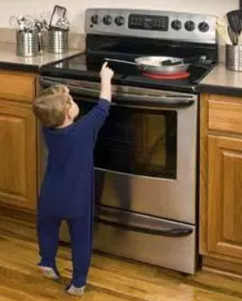
The Hot Stove

Slide 4
Cybersecurity in Small Business is primarily an “ignorance problem”
Don’t click on everything you see
Don’t open attachments you are not expecting
Don’t send confidential information via email
Don’t trust that email actually came from the person you think it did
Don’t check personal email at work
Question everything!

Slide 5
Mike Farlow
mike@comtechnc.com
336-570-9409 ext 100

