Slide 1
Emergency Management: Are you prepared??
Cone Health Emergency Management
Ben Wooten, MPA, CEM

Slide 2
Cone Health System
Based in Greensboro, North Carolina
5 county region of the Piedmont-Triad
One of the region’s largest, most comprehensive health networks
6 hospitals
100+ locations
11,000+ employees
60,000+ discharges
350,000+ ED visits
1,400+ physicians
1,200 volunteers

Slide 3
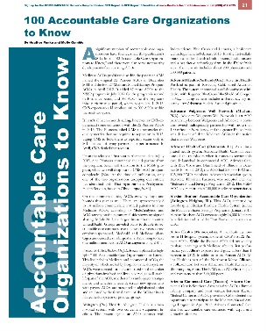
Recent Recognitions

Slide 4
Our Facilities

Slide 5
Our Facilities

Slide 6
Our Facilities

Slide 7
Our Facilities

Slide 8
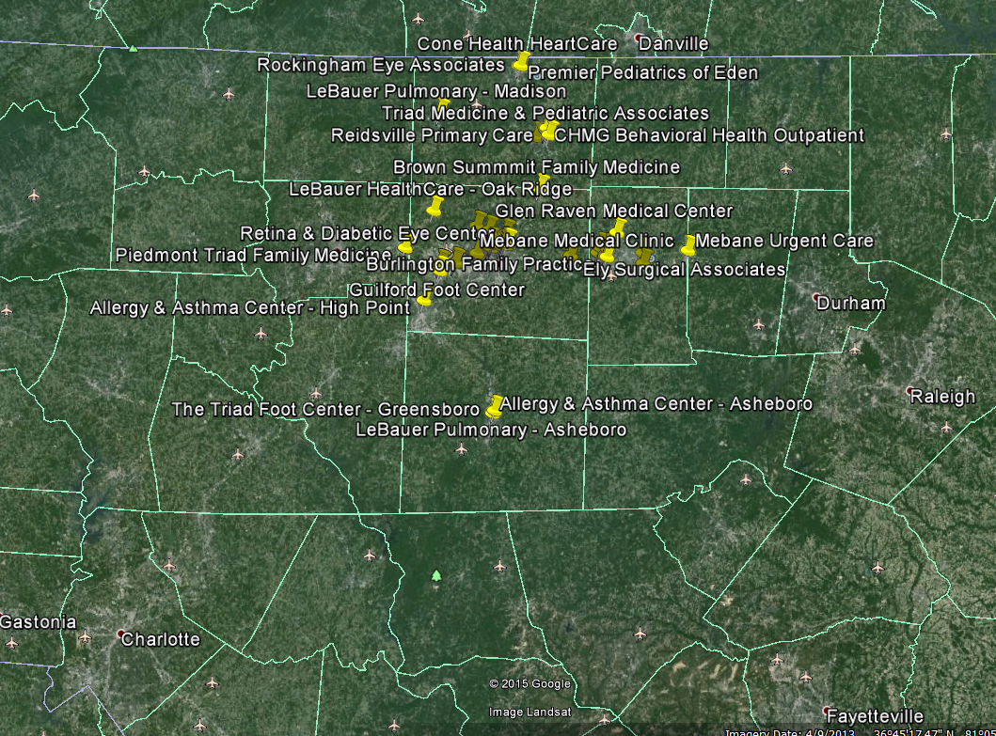
Our Region
62 miles
47 miles

Slide 10
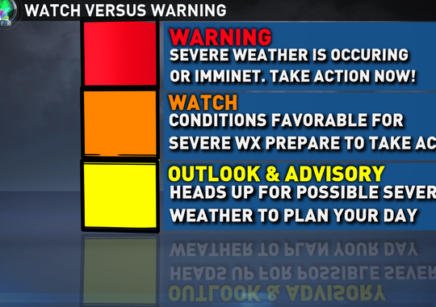
Know Your Alerts and Warnings
NOAA Weather Radio All Hazards
Broadcasts forecasts, warnings and emergency information 24 hours a day
Local Jurisdiction Emergency Notification Sytstems
Alamance County Emergency Alerts (A.C.E. Alerts)
www.alamance-nc.com/firemarshal/get-alerts
Text ALAMANCE to 888777
Smart Phone Applications
FEMA
American Red Cross
The Weather Channel

Slide 11
Types of Hazards
Tornado
Flood
Hurricane
Winter Storm
Terrorist Events
Chemical Spills
Others?

Slide 12
Create a Communication Plan
1. COLLECT.
Create a paper copy of the contact information for your family and other important people/offices, such as medical facilities, doctors, schools, or service providers.
2. SHARE.
Make sure everyone carries a copy in his or her backpack, purse, or wallet. If you complete your Family Emergency Communication Plan online at ready.gov/make-a-plan, you can print it onto a wallet-sized card. You should also post a copy in a central location in your home, such as your refrigerator or family bulletin board.
3. PRACTICE.
Have regular household meetings to review and practice your plan.
Text instead of calling
If you are using a mobile phone, a text message may get through when a phone call will not.
This is because a text message requires far less bandwidth than a phone call.
Text messages may also save and then send automatically as soon as capacity becomes available.
For Organizations:
Test internal communication systems to ensure all individuals in the organization can be contacted.
Designate individuals to be responsible for distributing alerts from official sources
Consider purchasing NOAA radios.
Encourage individuals to sign up for alerts and warnings, and assist them with finding any needed information.

Slide 13
Protect Your Critical Documents & Valuables
Household Identification
Vital records
Identification
Financial & Legal Documentation
Loan Documents
Housing
Financial Accounts
Insurance Policies
Medical Information
Emergency Numbers
Valuables & Priceless Items

Slide 14
Cone Health Emergency Management
System-wide Emergency Management Coordinator
2, Emergency Preparedness Specialists
Daily Hospital Functions
Plan for disaster response across the Health System
Infectious disease, IT failures, MCI, evacuations, facility damage, etc.
Educate Hospital Leaders through HICS & WebEOC classes
Plan drills and exercises for all facilities
Partner with community response agencies to ensure effective planning and response.
Respond to any and all emergency situations
Provide subject matter expertise to Command Center
Fill role as Command Center Manager and often as Planning Section Chiefs

Slide 15
Cone Health Emergency Management
Huge logistical support for all campuses and County Emergency Management Agencies
Communications Trailer & CISU Truck
New Motorola Turbo System w/ Interoperability
Employee Notification System - Everbridge
Multiple Heavy Movers
Generators
Decon Trailers
Mobile Hospital
Warehouse Inventory

Slide 16
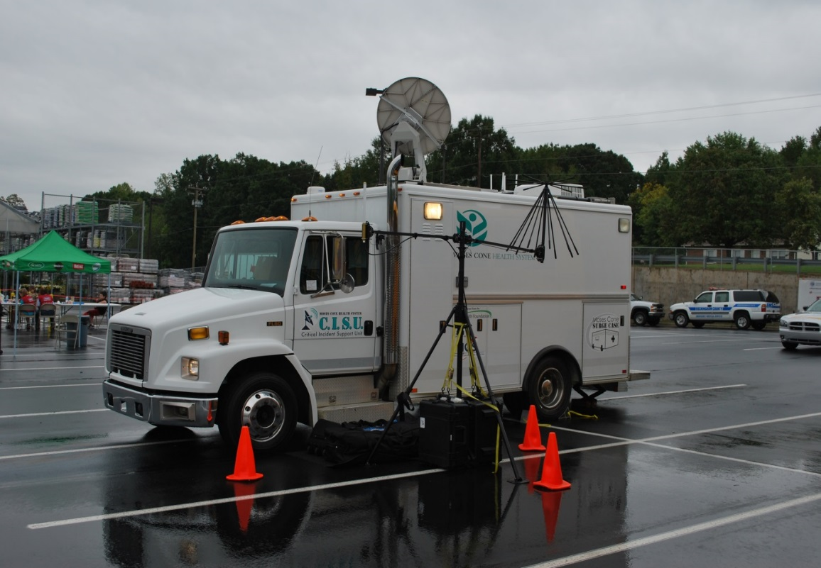
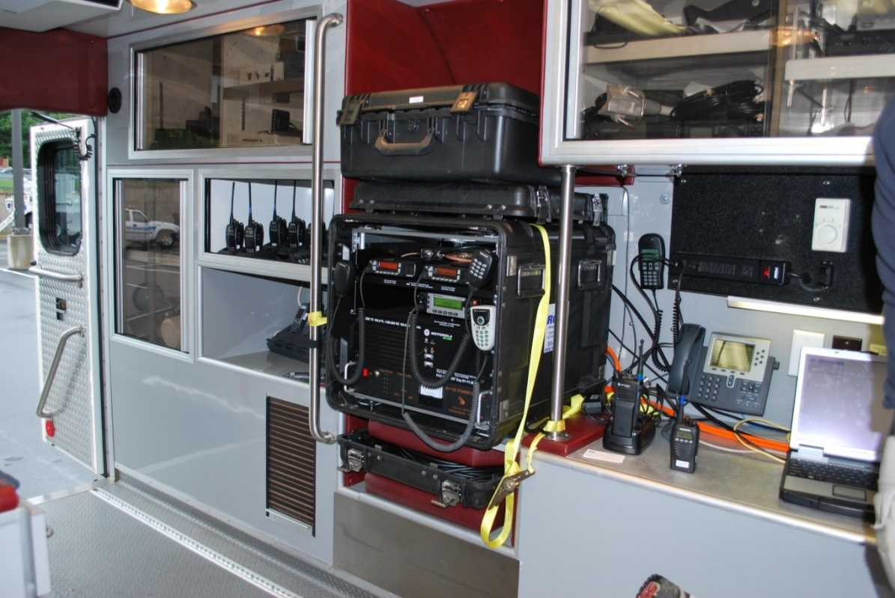
Critical Incident Support Unit

Slide 17
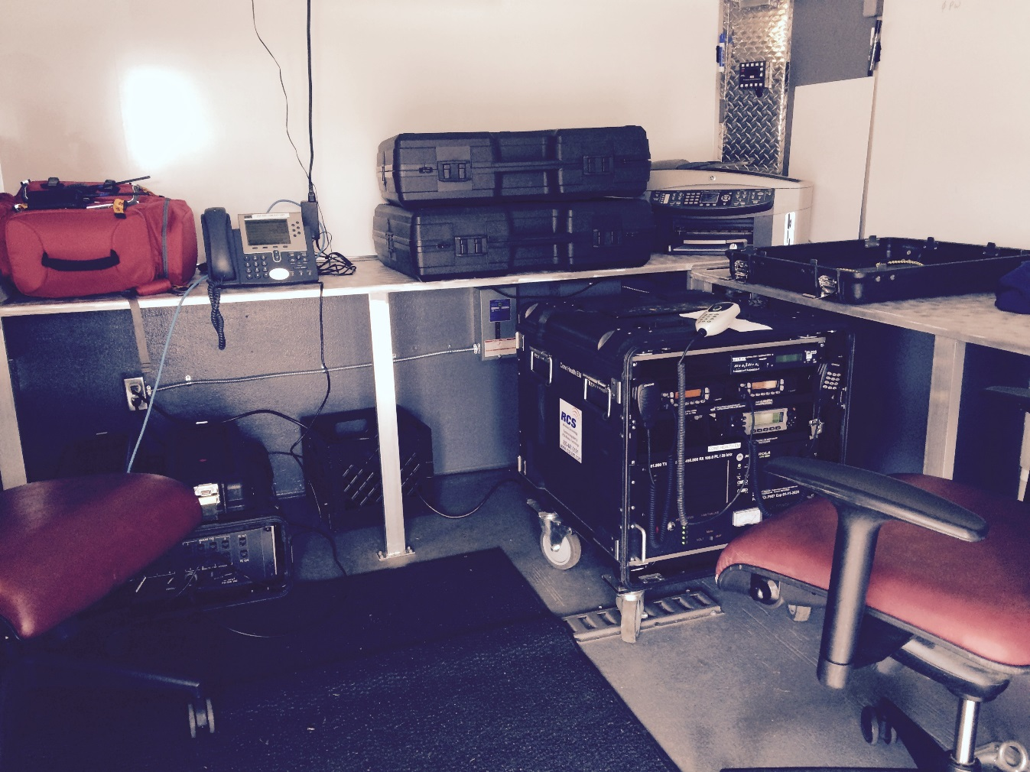
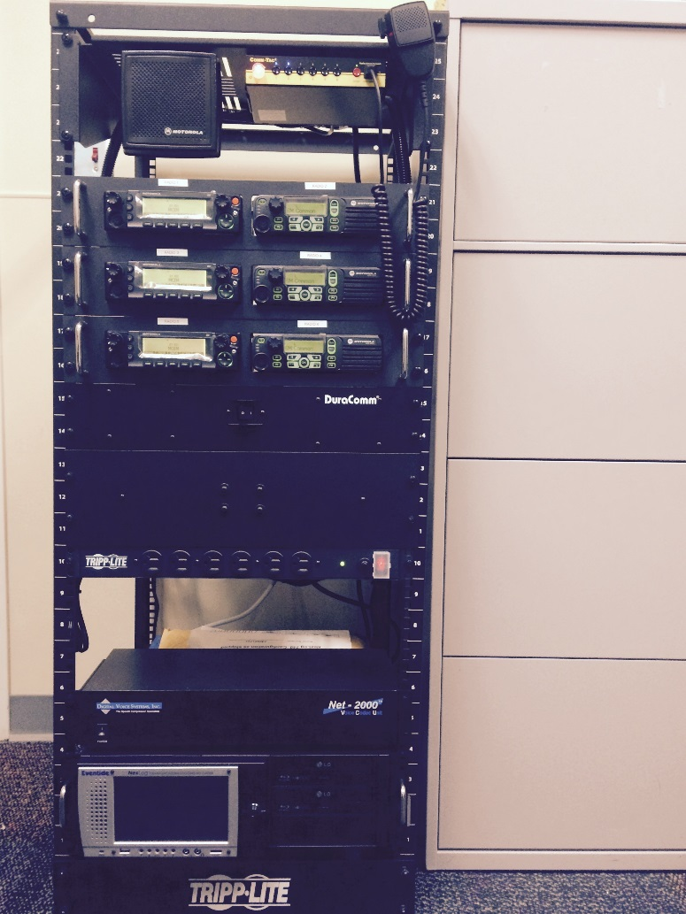
Communications Equipment

Slide 18
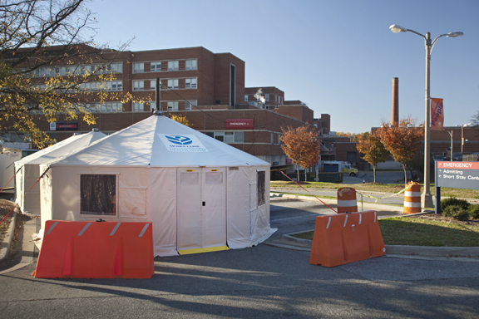
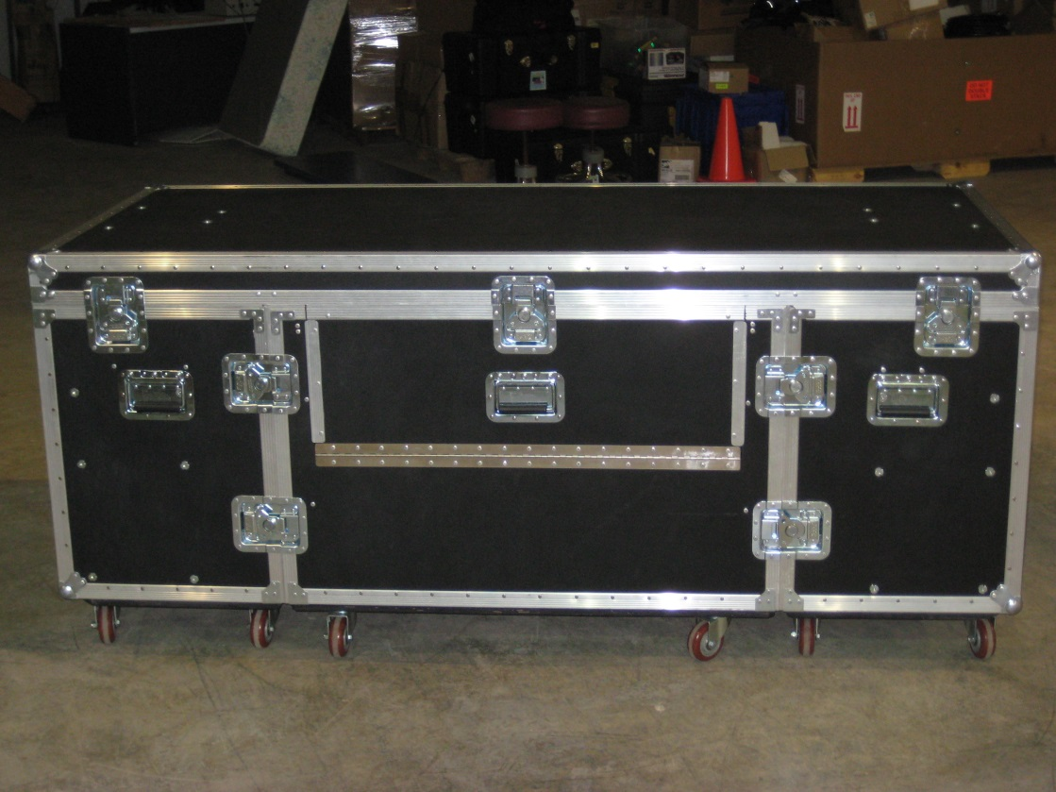
Mobile Hospital

Slide 19
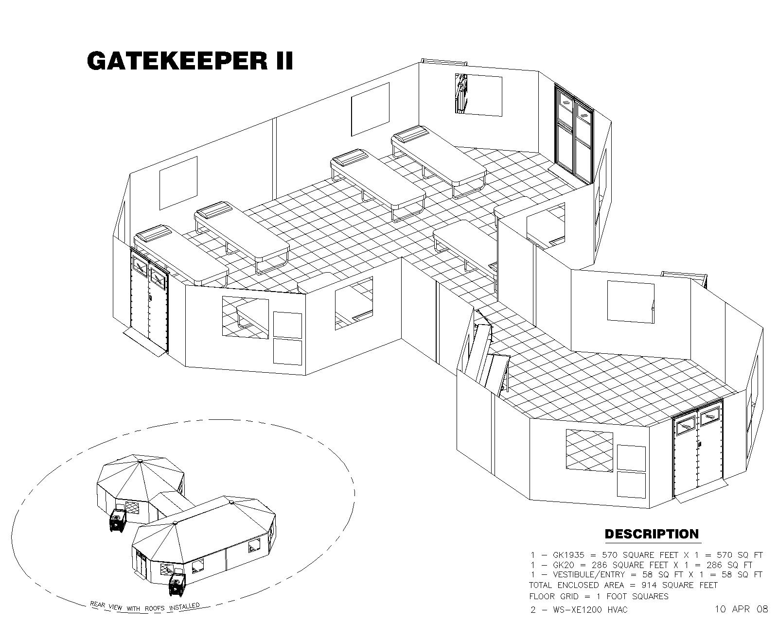
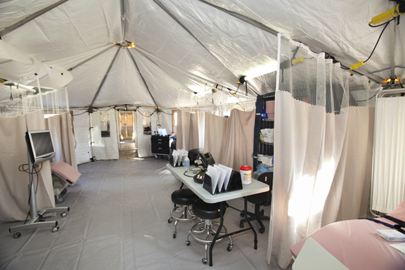
Mobile Hospital

Slide 20
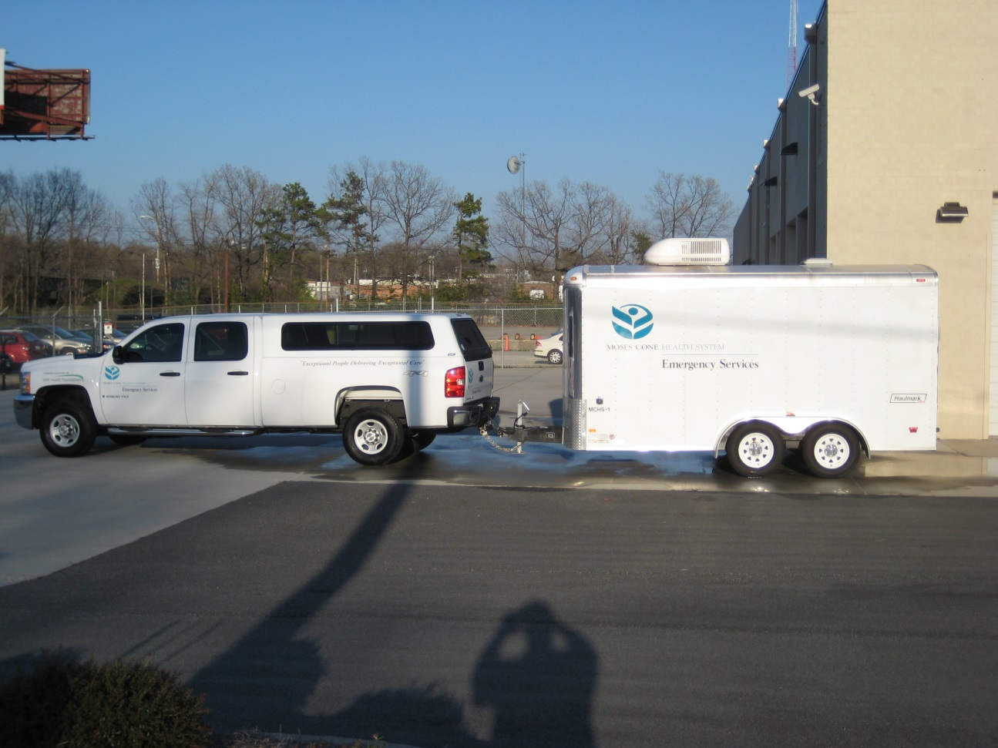
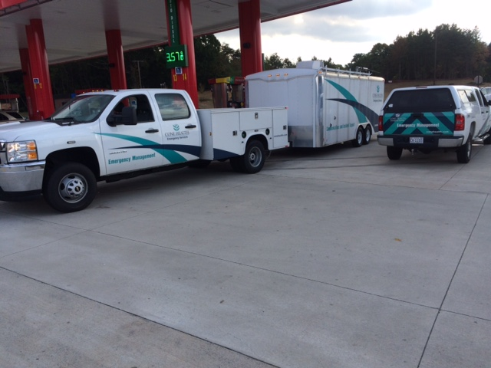
Trucks & Trailers

Slide 21
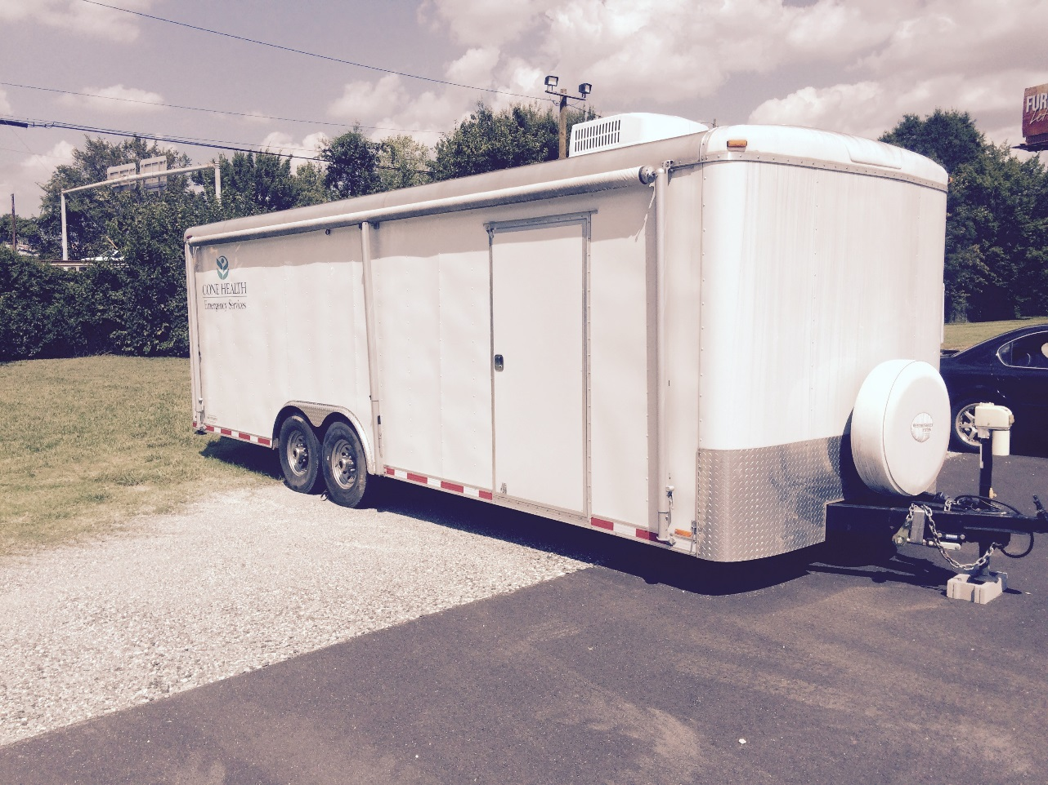
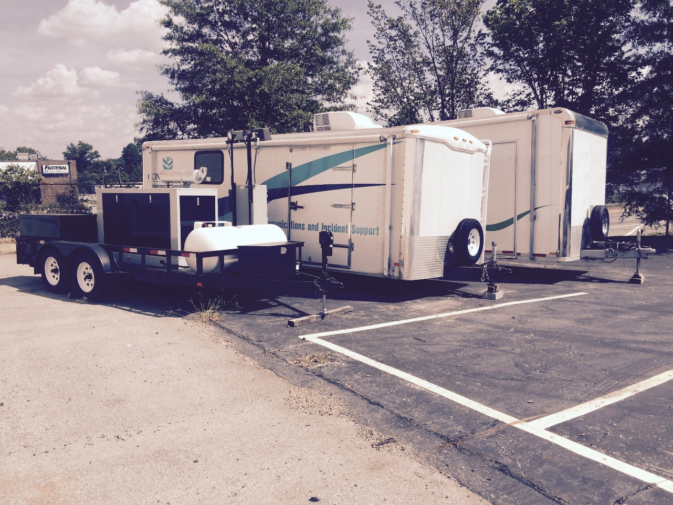
Trucks & Trailers

Slide 22
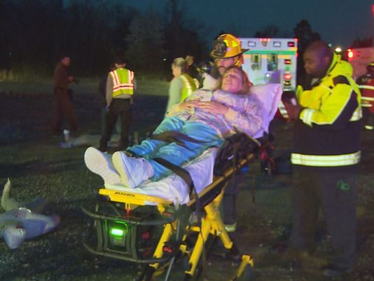
Collaboration – Community Response Partners
ARMC Mass Causality Drill
Passenger Bus Crash on Interstate 40/85
Involved all City & County agencies
Transport of patients to ARMC ED
Scene & Hospital Unified Command
Burlington Times-News Article
WFMY News 2 TV Coverage

Slide 23
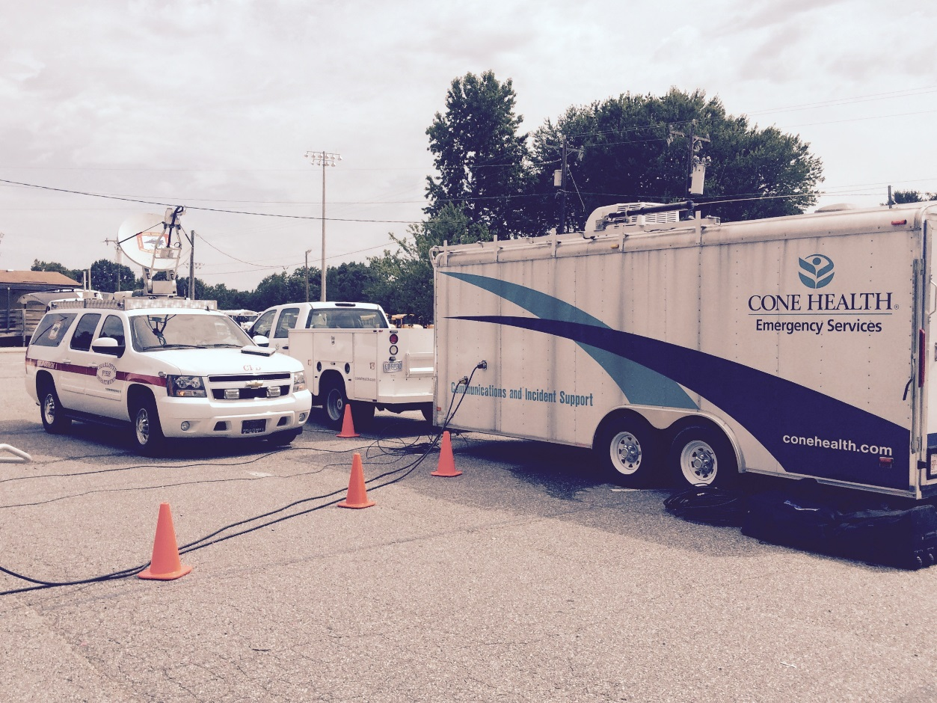
Collaboration – Community Response Partners
Communications Exercise
Guilford County EM
Alamance County EM
Guilford ARES
Alamance ARES
Greensboro Fire
Charlotte Fire

Slide 24
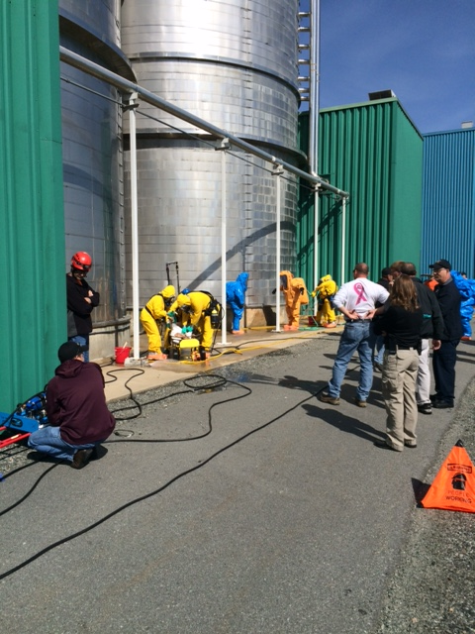
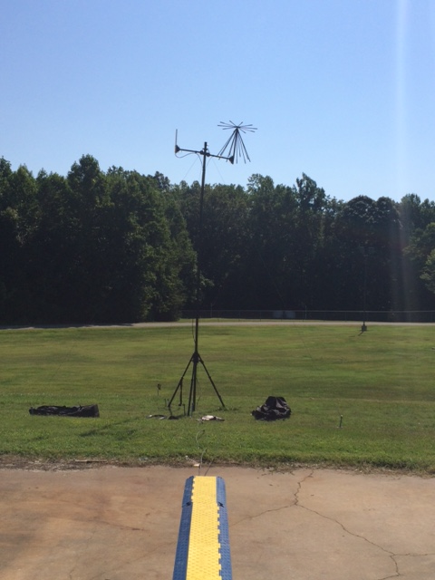
Collaboration – Community Response Partners

Slide 25
10 Ways to Participate
Access Alerts and Warnings
Test Communication Plans
Assemble or Update Supplies
Drill or Practice Emergency Response
Participate in a Class, Training or Discussion
Plan with Neighbors
Conduct an Exercise
Make Property Safer
Document and Insure Property
Safeguard Documents
America’s PrepareAthon
Community.fema.gov

Slide 26
Questions??
Ben Wooten – Emergency Preparedness Specialist, MPA, CEM
Email: ben.wooten@conehealth.com
Cell: 336-482-7921
Office: 336-586-3911

