Slide 1
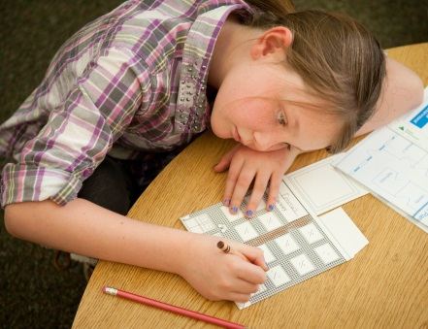
Financial
Literacy
Financial Literacy I Entrepreneurship I Work Readiness
Entrepreneurship
Work
Readiness
empowering young people to
own their economic success

Slide 2
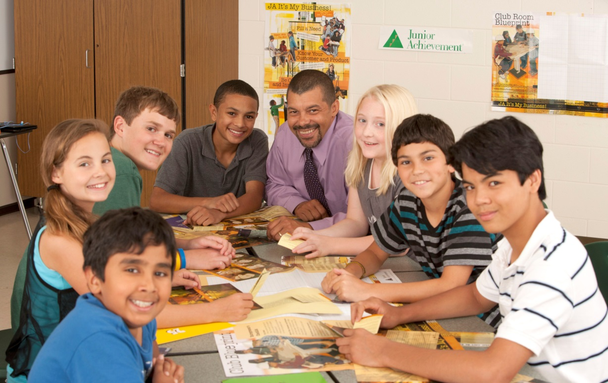
What is Junior Achievement?
Mission To inspire and prepare young people to succeed in a global economy.
Delivery K-12 Programs delivered by business and community volunteers
Program Pillars
Financial Literacy
Entrepreneurship
Work-Readiness
Notes:
JA is the fastest growing non-profit economic education organization
Our mission is…
We fulfill our mission by…
JA was founded in 1919 – we’ve been around for almost 100 years!

Slide 3
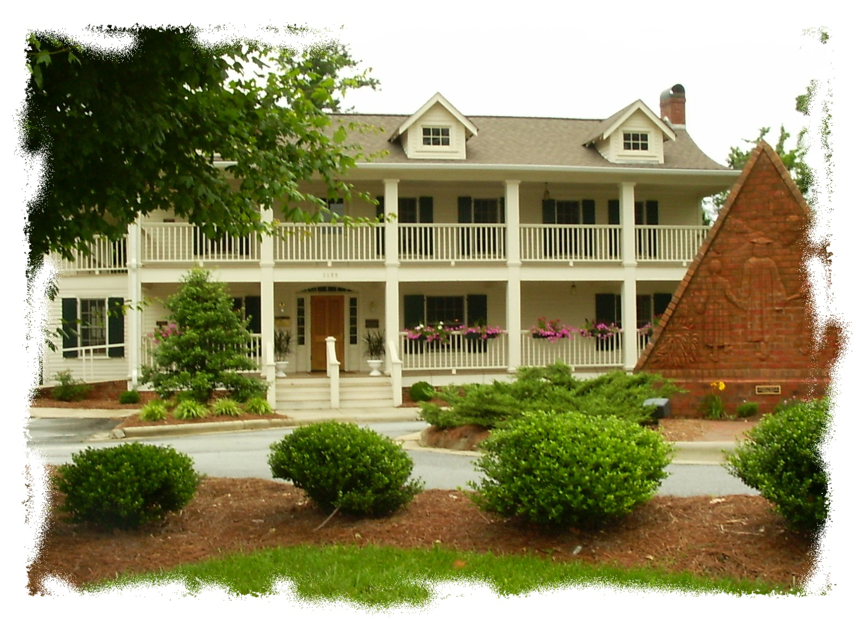
About JA of Central NC
We Serve
Alamance
Forsyth
Guilford
Montgomery
Randolph
Rockingham
Over 10,000 students served annually!
Notes:
Our chapter started in 1965 – next year is our 50th!
We cover six counties: Alamance, Forsyth, Guilford, Montgomery, Randolph and Rockingham
We typically conduct over 400 programs annually reaching approximately 10,000 students

Slide 4
Junior Achievement Benefits
Bridges the gap between learning and the real-world
Nationally-developed curriculum kits
Third-party evaluation
Impressive Results!
Notes:
Our programs span grades K-12 and are designed to be age appropriate
We are able to provide the programs free of charge to educators and students due to grants as well as individual and corporate contributions.
Overarching goal
Third party evaluator
Pre/Post tests across the nation, longitudinal studies (WIRE)
Relevance to current context of economy and ensure students comprehending material
Soft skills
Graduation rates

Slide 5
JA: Invest, Involve, Inspire
Successful
Community
Invest
Involve
Inspire
Investing in a well-prepared and well-educated workforce may be the single most important way to help North Carolina overcome barriers to remain economically competitive in the future.

Slide 6
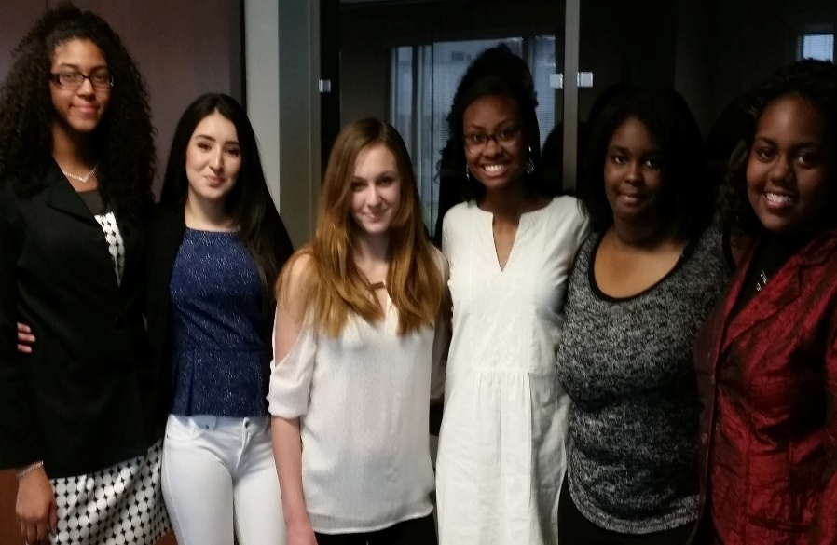
JA 5-Week Job Shadow Program
"I had always thought that I wanted to be an engineer, but then… I wasn't sure if it was right for me. The things I have seen here over the past weeks have made me sure that this is what I really want to do, because now I have seen all sides of engineering. Everyone here really enjoys their jobs, they have fun doing their work. Now I know I want to be an engineer because I know what an engineer really does.“
Hannah Wade, Engineering track
Business Partnerships
HAECO AVIATION
RALPH LAUREN
PRECISION FABRICS GROUP
LINCOLN FINANCIAL GROUP
DOW CORNING
UPS

Slide 7
Time Commitment
Junior Achievement is flexible… the volunteer and the teacher match schedules and make it work!
Elementary School Programs: 5 lessons, 30 minutes each (2.5 hrs)
Middle School Programs: 6 lessons, 45 minutes each (4.5 hrs)
High School Programs: 5-8 lessons, 45-60 minutes each (5-8 hours)

Slide 8
How does the process work?
Complete registration online: http://www.jotform.us/centralncja/javolunteer
Class assigned by JA Programs Manager, Gale Murphy
Attend new volunteer training and/or pick up your kit
Volunteer contacts assigned teacher to arrange class schedule
Volunteer completes class assignment
Complete program evaluation and return to our Programs Manager
Pat yourself on the back.
You just inspired a classroom full of students and shared a message of hope and opportunity!
Register to volunteer again!

Slide 9
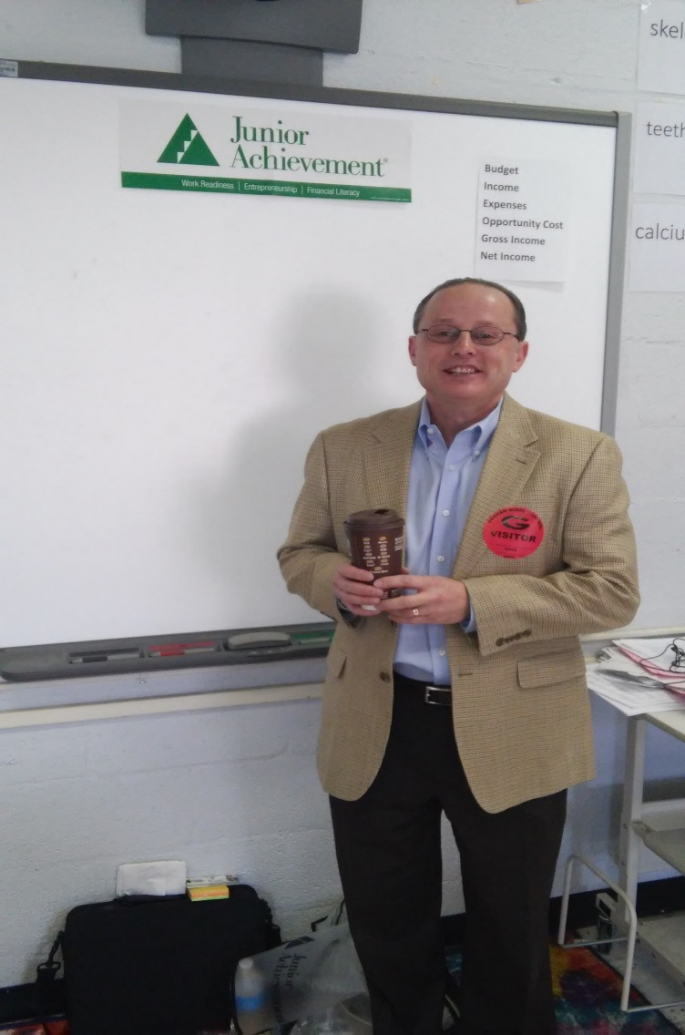
How can you/company get involved?
Classroom Volunteers
Traditional delivery
“JA in a Day”
1-Day Job Shadow
Reverse Job Shadow
Career Fairs
Mike Davis
VP, LabCorp

Slide 10
Our Future Workforce
Help our young people make the connection between the classroom and the real world.
Teach them the skills they need to own their own economic success and prepare for their future.
To help them get ahead tomorrow, teach them about reality today.

Slide 11
Questions?
Gale B. Murphy, GCDF, CWDP: BES
Programs Manager
(336) 544-0342
gmurphy@centralncja.org
www.centralncja.org

